Slide 1
COMPANY NAME
VALUE PROPOSITION
Presenter Names | Jessica Jones | Max Mustermann

Slide 2
STORY

Slide 3
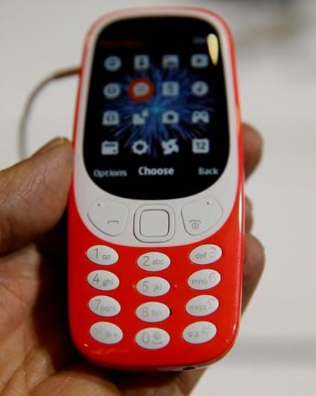
PROBLEM
Problem no. 1
Compelling emotional problem
Problem no. 2
Rational quantifiable problem
Problem no. 3
Another problem

Slide 4
Converging Trends
70%
70% increase in smartphone use in USA 2019
28%
28% increased discretionary spending on technology in USA 2019
10%
10% decrease in Brand loyalty in luxury technology goods
Important data up there…

Slide 5
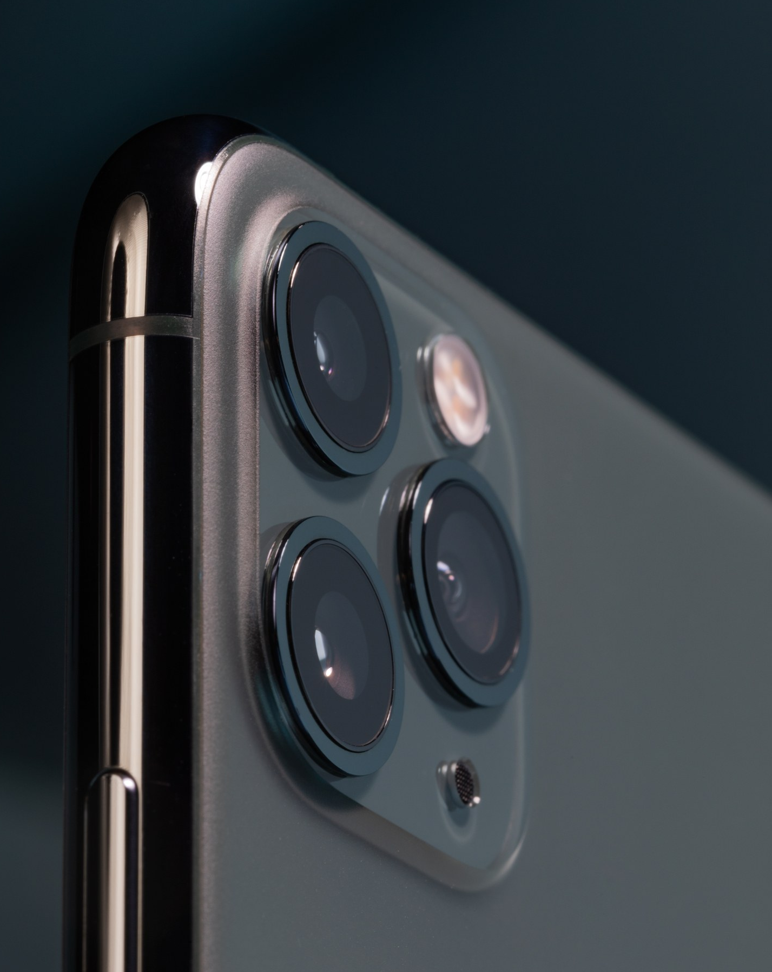
Solution
Key attribute 1
Compelling Value proposition
Key attribute 2
Its also really cool because
key attribute 3
3 Cameras take better pictures

Slide 6
Target Market
40%
68%
88%
4%
Play Chess
Like Rock Music
Love Nature
Eat Fast Food
70% of our customers are looking for our solution
70%

Slide 7
Market Overview
2.8B
TAM
SAM
SOM
Total Addressable Market
Serviceable Available Market
Serviceable Obtainable Market
642M
28M

Slide 8
Competition & Differentiation
Branded Experience
Additional information
Custom Built
Additional information
Science Based
Additional information
COMPANY

Slide 9
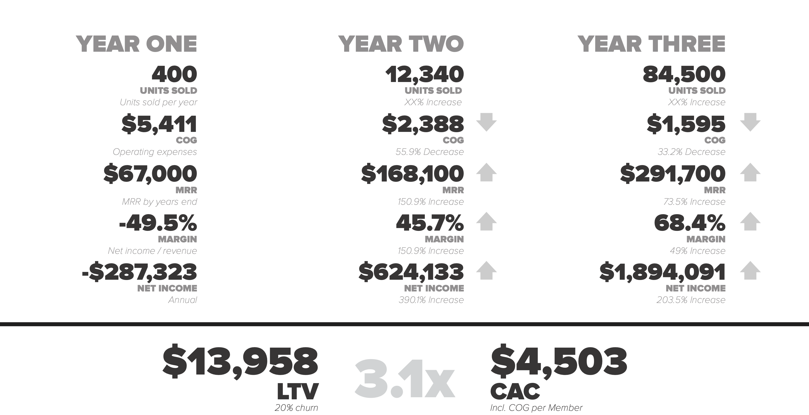
Strong UNIT ECONOMICS

Slide 10

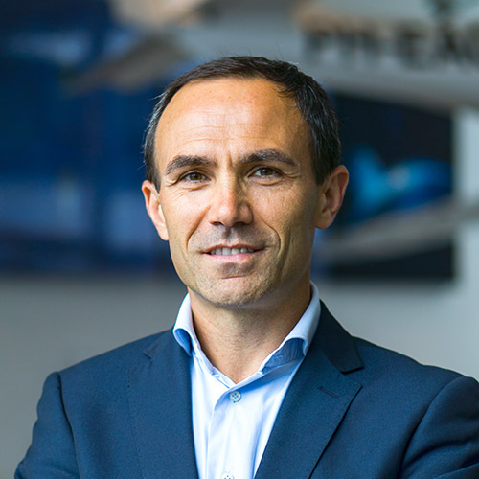
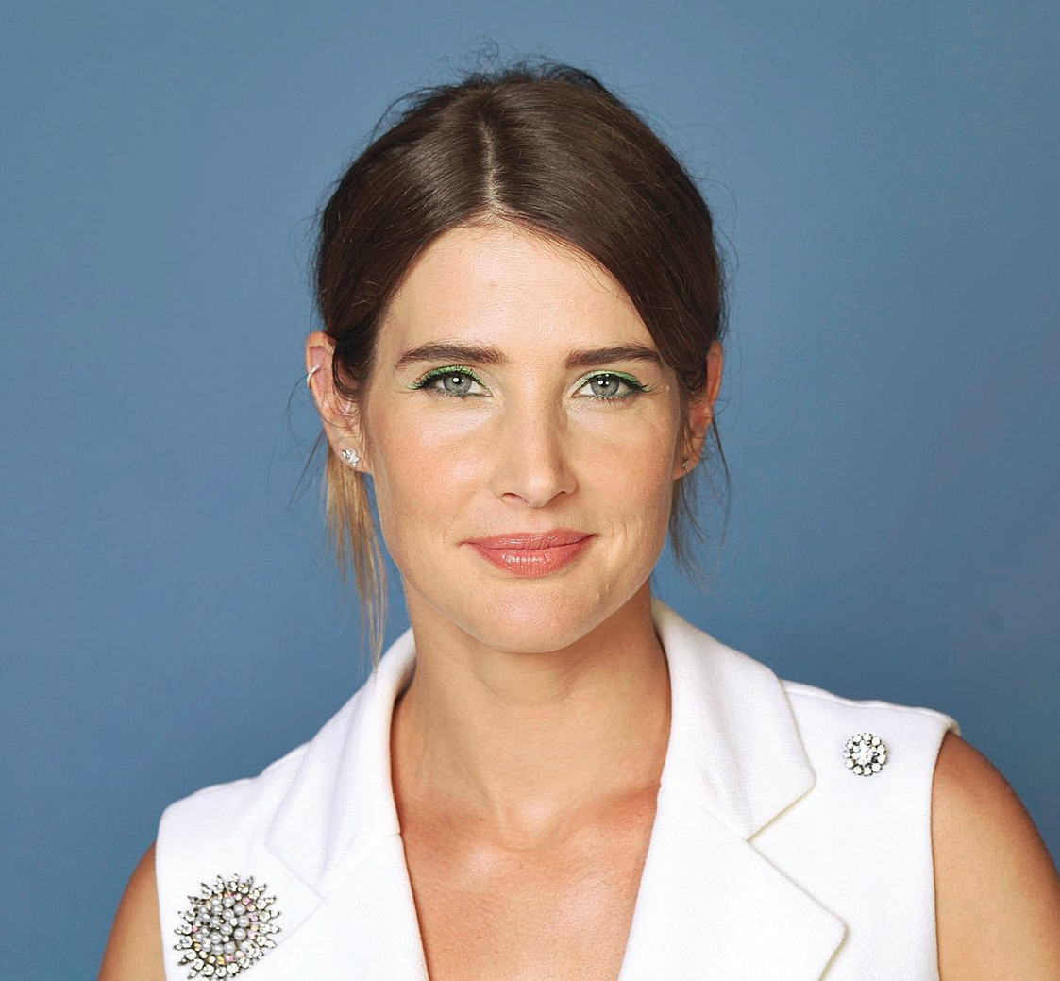

Incredible TEAM
Alan Doe
Sarah Doe
Important information here
Important information here
CEO / Founder
Manager
Product
CTO
Steven Doe
Jonah Doe
Important information here
Important information here

Slide 11
GOING FORWARD
Build MVP
Additional information
Launch
Additional information
Hire Awesome Guy
Additional information
Use of funds
Next Steps

Slide 12
Thank You
Contact
Your Name
Your Email
Your Phone Number
Other Contacts (if any)

Slide 13
Financials
One-year profit and loss statement & Sales projections for year 2 and 3
It should have some level of detail
Methodology behind the numbers
Be aggressive but realistic
Summary on the slides, detail on the “Sneaky Slide”
Notes:
Less is more
Words on a slide

Slide 14
Some Thoughts
Story + Data
Less is more
Use charts and pictures
Engage your audience
Introduce your entire team
Practice. Practice. Practice.
Be confident
Answer the questions
Notes:
Less is more
Words on a slide

Slide 15
Rubric
Presentation (150):
Concept Statement: Team addresses an important opportunity to solve a problem/pain (25)
Team has a business model that is feasible (20)
Team has done direct research of business market (20)
Customer Discovery has been conducted (20)
Cost and pricing model is reasonable (15)
Team addresses secret sauce/competitive advantage (15)
2-3 next steps are clearly defined (15)
Overall Presentation Quality (20)

Slide 16
Thank You
Contact
Albert Napoli
anapoli@marshall.usc.edu

